Slide 1

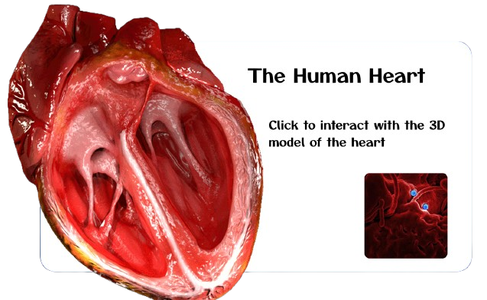


MeyRAR
CardioAR
-Hackreality-spatial-computing,December,2024
Kelvin Fosu

Slide 2
The Problem
cardioAR
Over a month, our team lead found great interest in the YouTube channel Our History. The channel has a subchannel called, Autopsy, where doctors talk about why some famous stars suddenly die. He noticed a trend in about 99% of the autopsy reports that most of them die from cardiac arrest or respiratory issues due to unhealthy lifestyles like excessive smoking and snouting of illegal drugs, overworking, lack of sleep, and alcohol abuse.
This was a popular trend in the 90's for stars.; The moment you become a star 🌟 , you need to have a cigar 🚬 . This was part of their costume because by then, the contemporaries of that period did not know about the adverse effects of smoking.
It was this that inspired him to get us to work on cardioAR to help inform/educate people about the heart and lungs as these organs are vital to our well-being and can cause serious health issues when not cared for.
MeyRAR

Slide 3
Process
Research
Get Audio, 3D assets & Design UI
Developing the AR experience & Adding interactivity
Testing and Publishing
01
These are our guide to developing cardioAR
02
03
04
MeyRAR-cardioAR

Slide 4

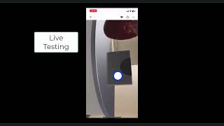
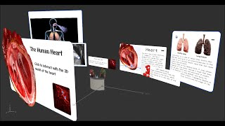
Demoo
cardioAR
Watch video here:
https://youtu.be/i-xSgT5BYrc
Watch video here:https://youtu.be/0RAAwcM-hSg
meyRAR

Slide 5

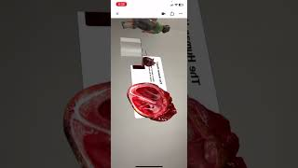
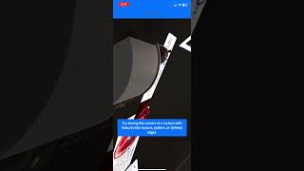
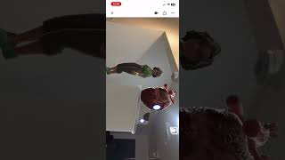
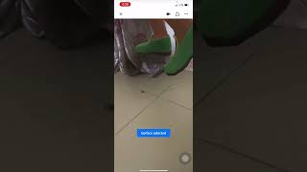
Failures-Live Test
cardioAR
Watch other test failures: here
meyRAR

Slide 6

Scan me
cardioAR
Scan to launch
The Ar experience
Follow how to test:
Test with Android-Beta: link
Test with IOS Device:link
Use the next slide
To know how to interact with the assets.
MeyRAR

Slide 7
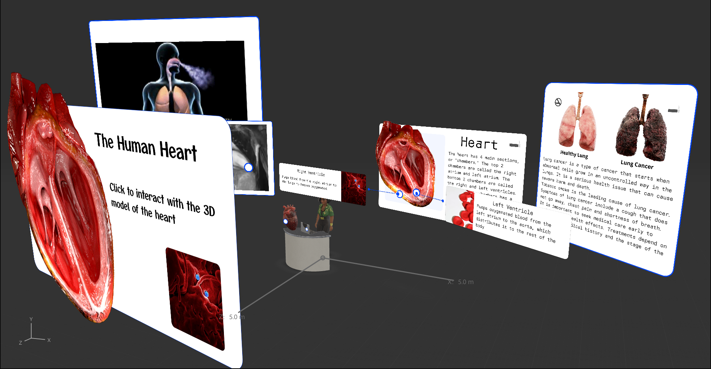
4.Click on the hotspot to display the UI of the left ventricle or tap the other close hotspot to show the right ventricle
3.Click on this hotspot to display the UI of a gif of the cross section of a heart. And click on the hotspot on the left to display a gif of the inhaling/exhaling process.
2.Click on the hotspot to display the UI’s on the right side
1.Click on this on start of scene
5.Click on the cigarette icon to show a healthy & unhealthy lung.
Kindly note that the blue and white bouncing circles, indicate that they are clickable( will show a UI with information).
7.Click on the hotspot
On the laptop to show all
the UIs.
6.Click on Zara to
hide all the UIs.

Slide 8
Test cardioAR
meyRAR-cardioAR
Watch test video 1:
Scan to launch
The Ar experience or use:
https://youtu.be/ZfEZE10CSfk
Watch our slide:
https://bit.ly/CardioAR-Demo
https://bit.ly/cardioAR
Remix cardioAR:
Project on Github:
https://bit.ly/remixCardioAR
https://bit.ly/cardioArGit
Project on DevPost:
https://bit.ly/cardioArDevPost
skapezMpier

Slide 9

Use the below link to understand devices that can run Aero
System Requirements:link
System Requirement

Slide 10
Remix cadioAR:
CardioAR
Requires Adobe account setup
Download Adobe Aero: here
Download Editable Aero file of cardioAR:link
Double click to launch the project in Aero
Start editing
Watch a quick guide here
meyRAR

Slide 11
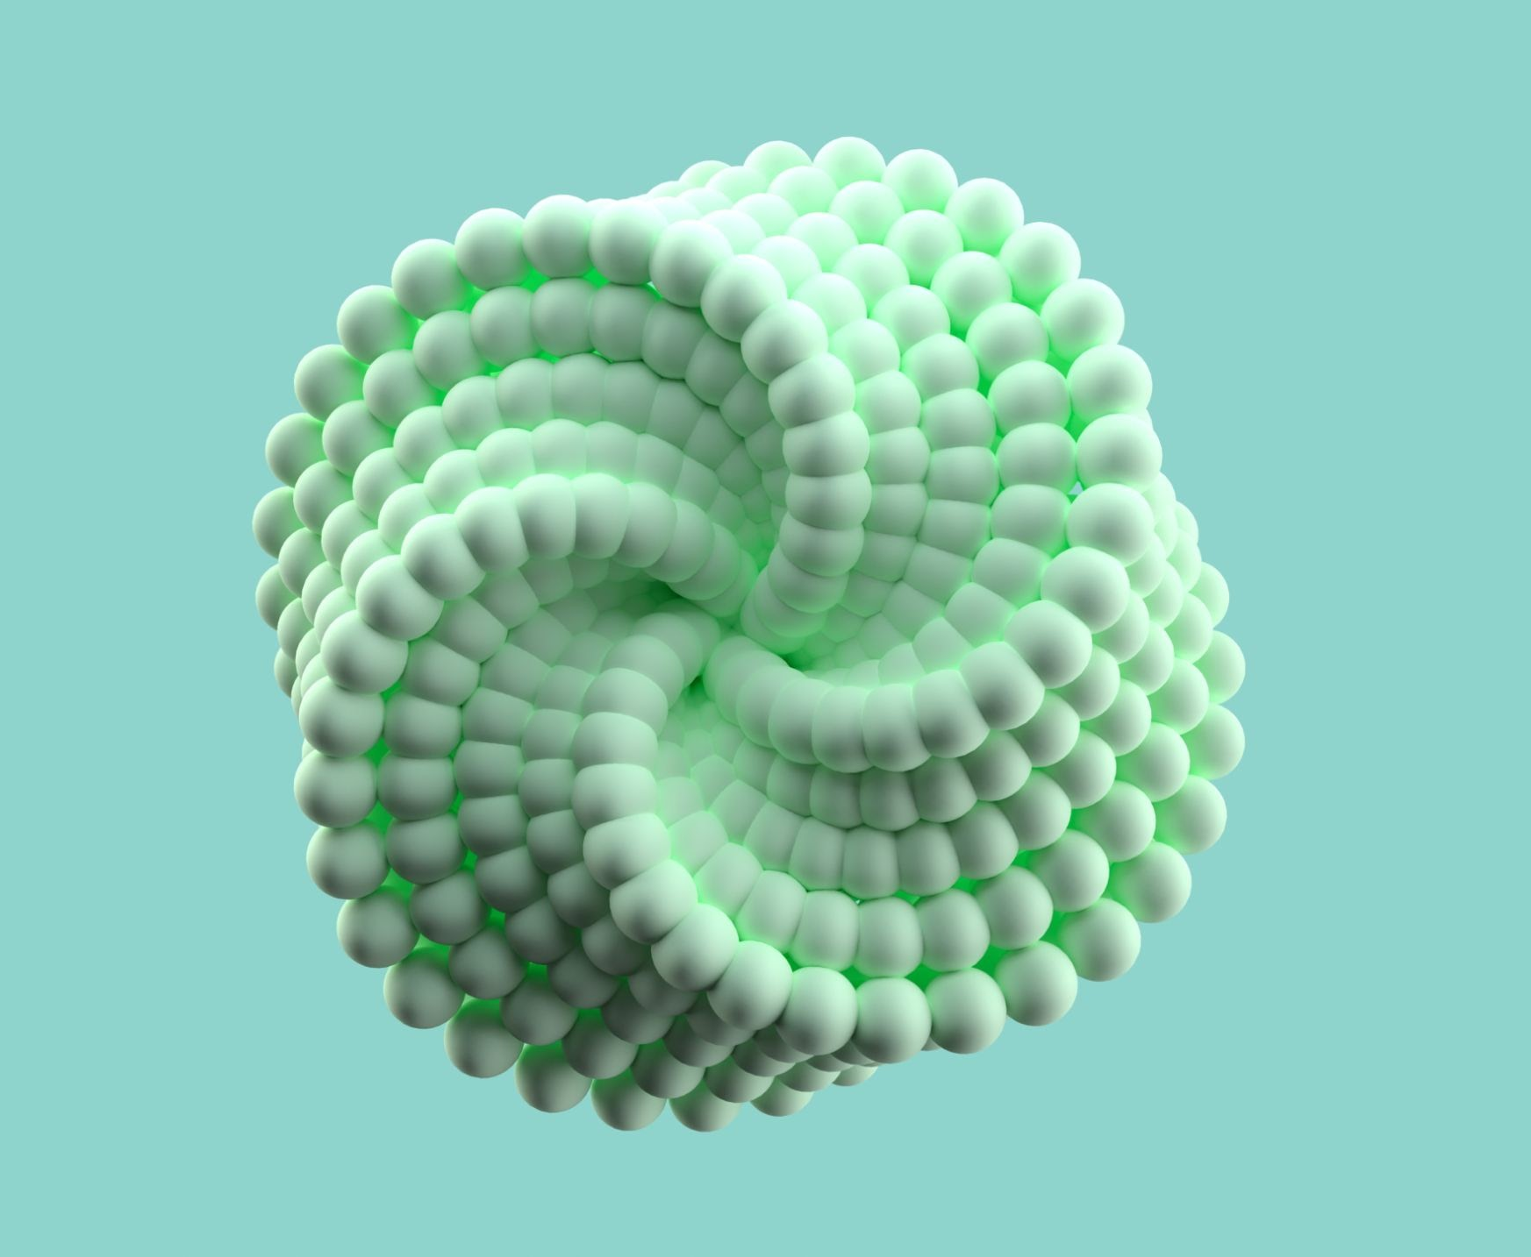
Resources
Technical Stack:Adobe Aero, Figma
Test Project: link
GitHub:link
Realistic Human Heart:link
Lung and heart image:link
Heartbeat sound:link
Heartbeat gif:link
Respiration gif link

Slide 12
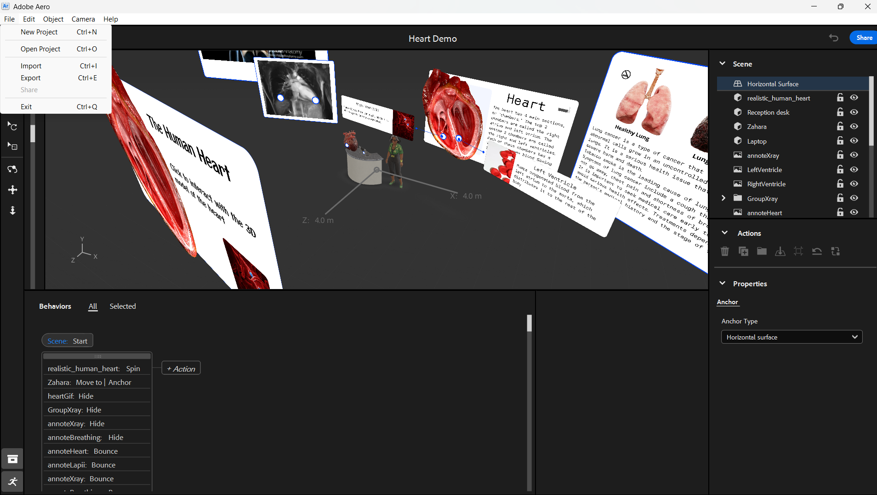
This shows all assets in your scene; your can toggle visibility and rename them
Click on file
to import an existing Aero
File.
Or Click on export to export your project to your computer
Interactivity in action.

Slide 13
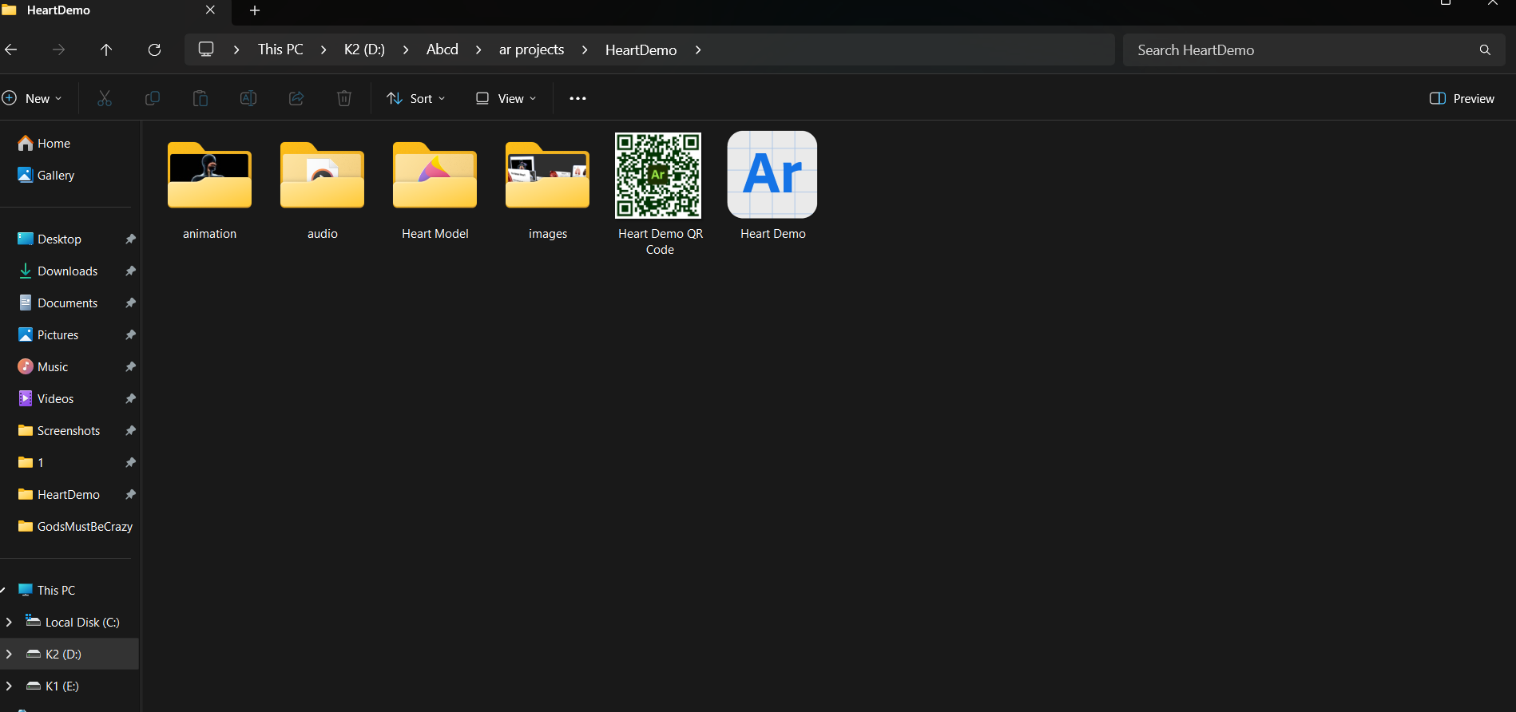
The editable Aero file that has been exported on a local machine.
This can be imported into the Aero software

Slide 14
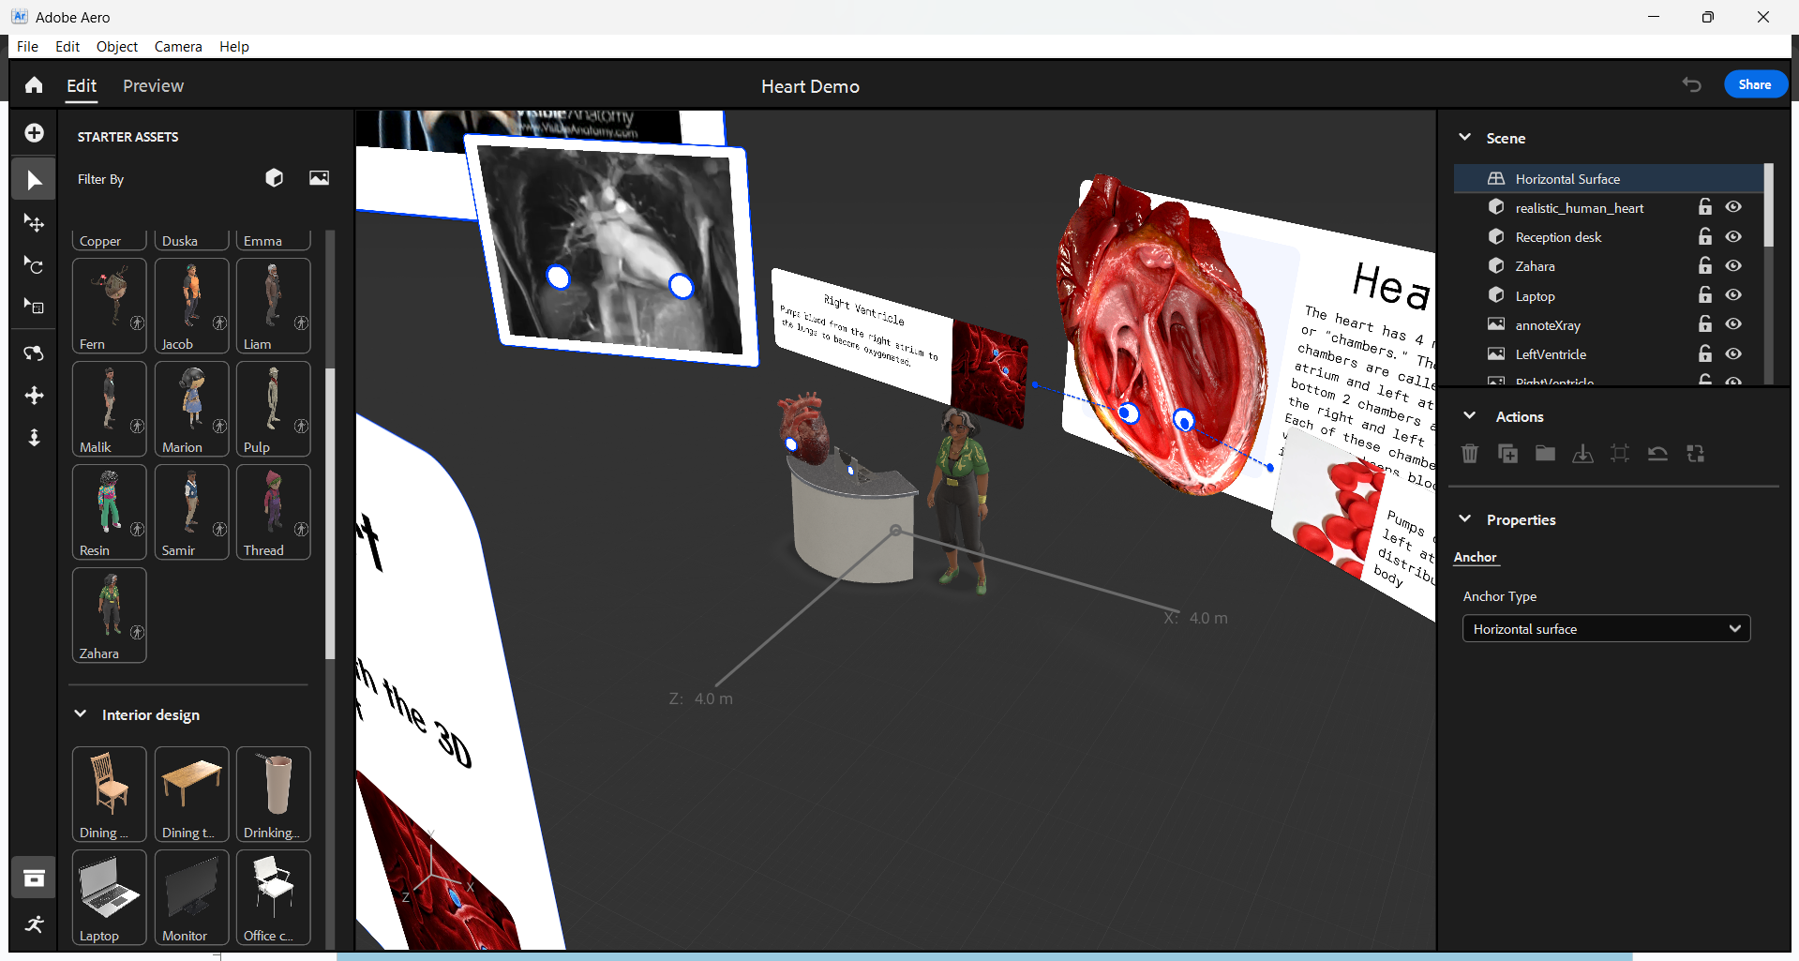
Your control tools like scale, select, rotate, import, pan etc
Laptop, female character and table can be found in the starter Assets pane
Whatever asset you select, it’s properties like position, cordinates, scale etc will be shown here.

Slide 15
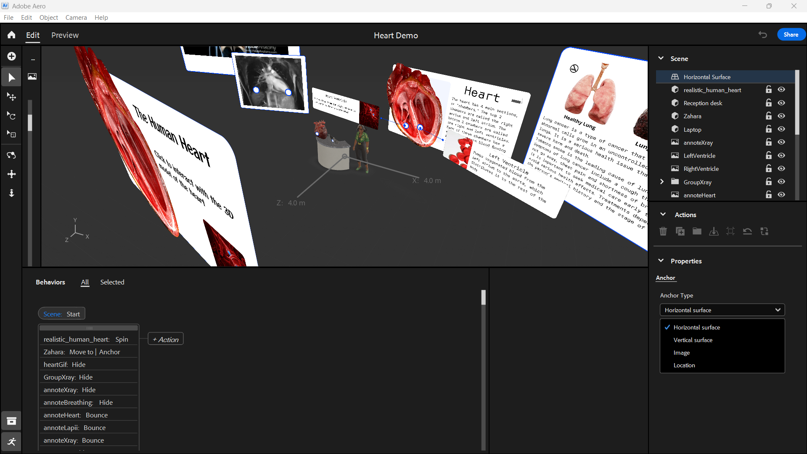
Working environment
These anchor
Type allows you to select the type of experiences.
Example,
A vertical surface for this like paintings etc
Click on this to add interactivities to your assets
Interactivity in action.

Slide 16
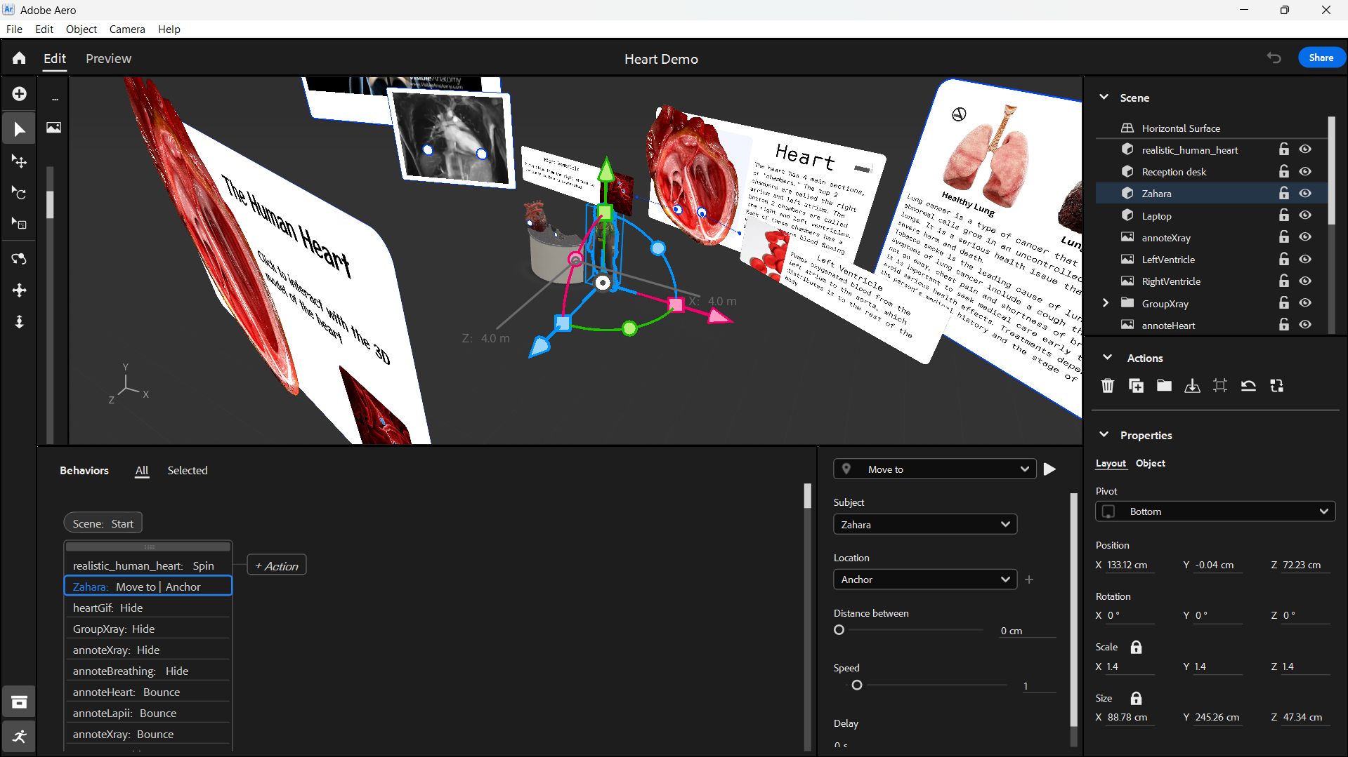
Click on share to push your project to your Adobe Aero account to host the project
The handle allows you to scale, move, rotate etc your assets.
Click on preview to have a full view of how your project will look like or to test your project
Properties to add custom interactivity to your assets
Properties to add custom interactivity to your assets

Slide 17
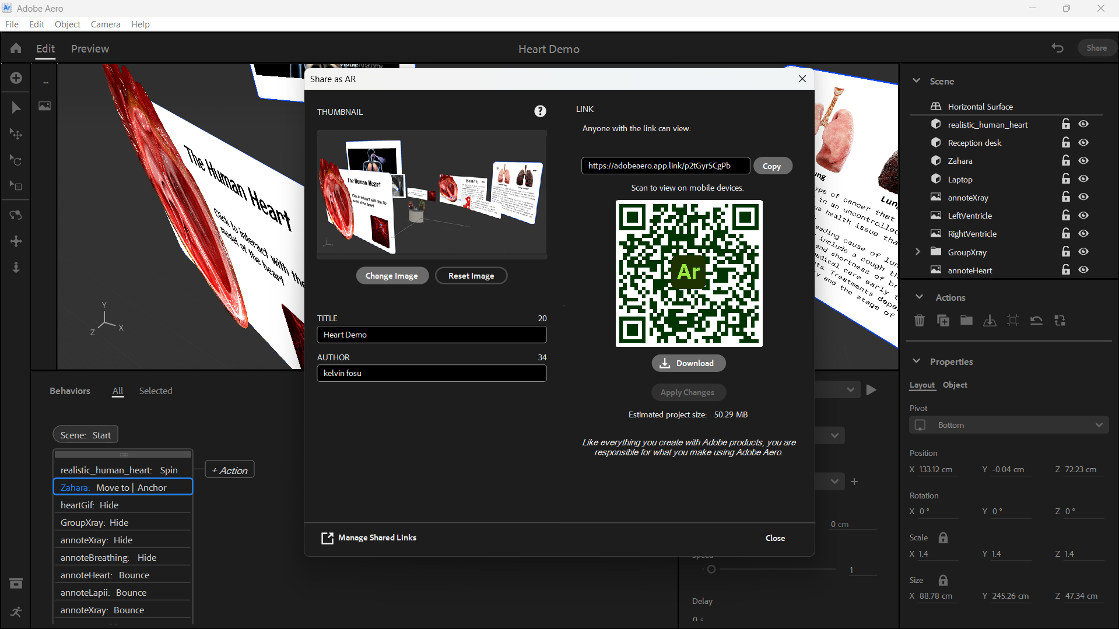
CLick here to add your own
Custom cover image
Download SHareable
QR code.
Copy shareable link so people can interact with your final work.
Click on this
To update changes you make in your project
Note that, any project, greater than 50MB slows the AR experience

Slide 18


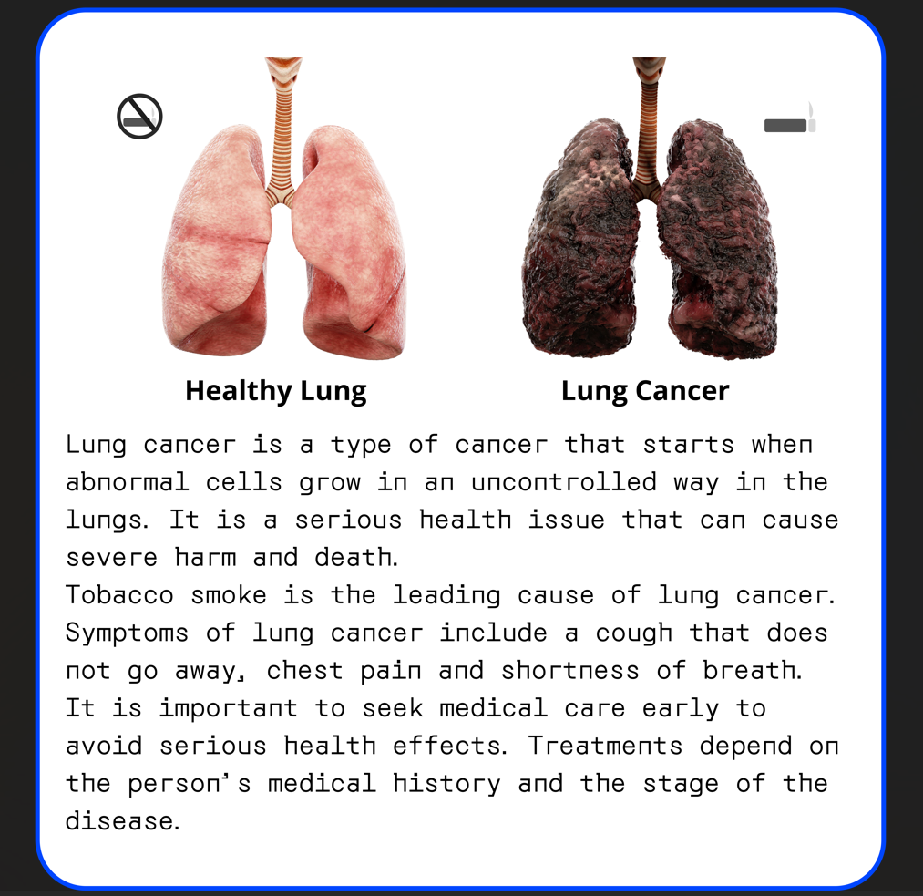
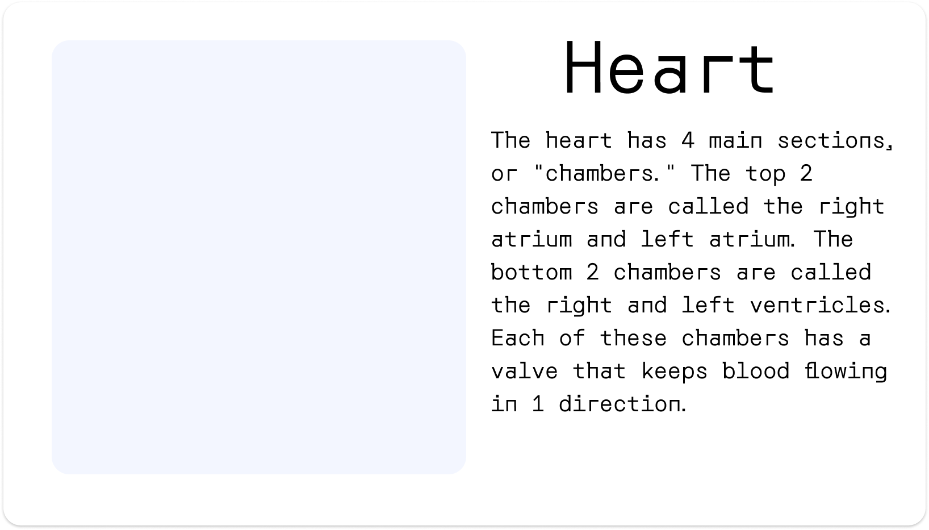
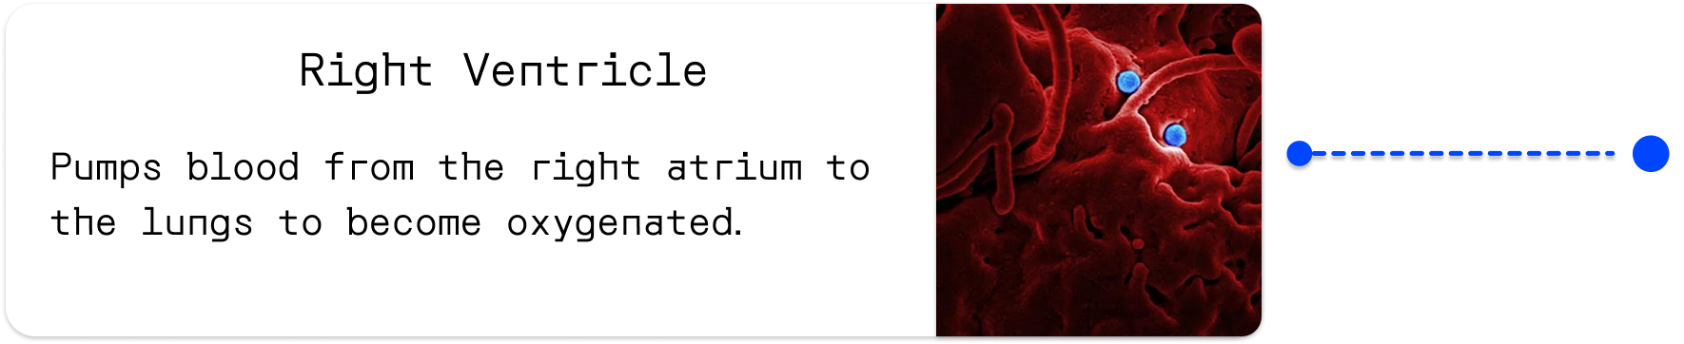
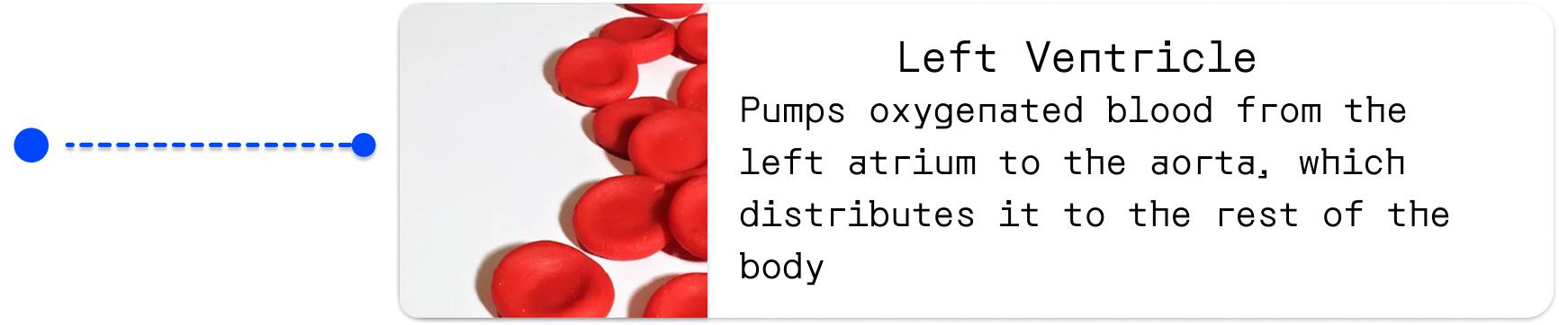
Some UIs Designed in Figma

Slide 19
Scale
meyRAR-cardioAR
Add interactive quizzes via Google Forms
Build more Ar science projects
Build a React App to house projects
Add more annotations to parts and add more 3D models
Migrate to other tools like Unity, modelviewer, three.js
Change name to match a universal name so we can have varied 3D subjects.
Disable the tap on card to toggle visible feature to using a close icon on each card to toggle visibility.
skapezMpier

Slide 20
Thank you
Yet another experience with
Thanks to our Testers
Winifred Asantewaa Asante
Prescott Nyamekye
Francis Ocrah
Christian Kusi
Francis Appoh Acquah
Laureate Amissah
Jibril Ocansey
meyRAR
skapezMpier
Linkedin Facebook
Team
Contributor-Research
Eliel Kwesi
Lead AR/ UI Designer
Kelvin Fosu
Contribution-Documentor
Gladys Ayebia Ashong

